Slide 1
Applied Physics(Computer Science) BS CS Semester-I Course Code: L=0(Introduction to Course Out lines) IUB & All Affiliated Colleges. Reality Awards Boost Up (YT-Channel)
Rushmat Ali
Assistant Professor of Physics
Govt. Kh. F. Graduate College R.Y.Khan

Slide 2
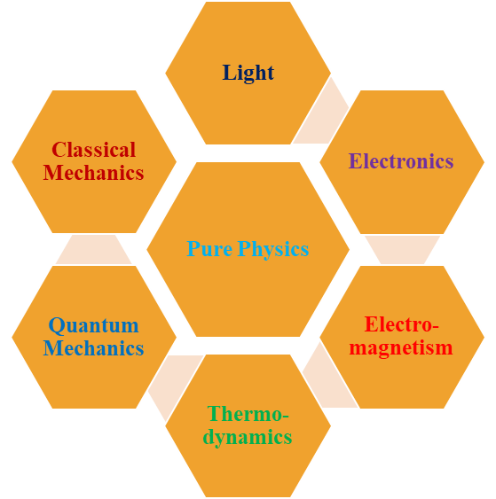
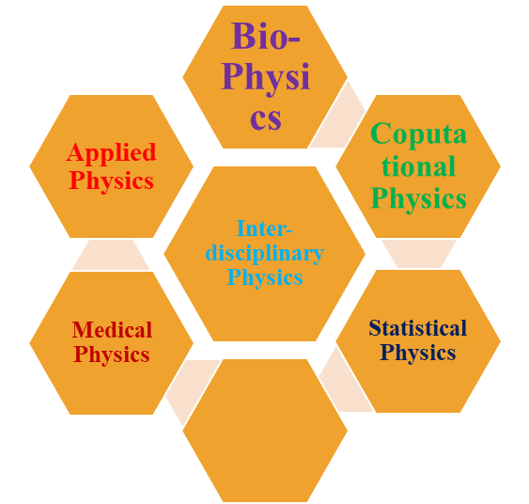
Origin of Applied Physics
What is Physics?
The branch of science concerned with the nature and properties of matter & energy.
It studies objects ranging from the very small using quantum mechanics to the entire universe using general relativity.
Branches of Physics:
1. Pure Physics 2. Inter-disciplinary Physics
Applied Physics:
The application of physics to solve scientific or engineering problems.
It is usually considered a bridge or a connection between physics and other branches specially Computer Science.
The hardware of computer is a basic physics

Slide 3
Applied Physics
BS CS Course:3 Cr. Hrs. Course Code: GNS-00111
Brief introduction of the course:
➢ This physics course offers a broad introduction to the core principles of natural science.
➢ It encompasses foundational topics such as forces, motion, energy, and thermodynamics.
➢ Additionally. It explores optics, renewable energy sources like solar cells and wind energy, meteorological phenomena, and pressing environmental inmates such as the greenhouse effect and global warming.
➢ The course also delves into the behavior of electric and magnetic fields, addressing electric charge.
➢ Coulomb's law, electric potential, and current. With a comprehensive approach to physics

Slide 4

Learning Methodology & Evaluation
Applied Physics
Teaching Methodology:
❖ Lecturing.
❖ Written Assignments,
❖ Project, Experiments,
❖ Report Writing
Course Assessment:
Mid Exam, Marks:20 Sessional Marks: 20( 5+5+5+5)
Home Assignments, Quizzes, Attendance, Behavoiur
Experiments,
Final Exam, Mark:60

Slide 5
Intended Learning Outcomes:
After learning this course, students should be able to fundamental principles in physics, including concepts relied to forces, motion, energy, thermodynamics optics, and electromagnetism.
Comprehensive Understanding:
Upon completing this course, students should have a deep understanding of
Application Skills: Students should be able to apply their knowledge to practical situations, such as solving physics problems, explaining real-world phenomena, and making informed decisions related to energy sources and environmental concerns.
Critical Thinking and Problem-Solving: This course aims to enhance students' critical thinking and problem solving skills by challenging them to analyze complex physical scenarios, develop solutions, and make connections between different areas of physics
Environmental Awareness: Students will gain an awareness of the impact of physics on environmental mal issues, particularly in understanding global warming, and sustainable energy sources

Slide 6
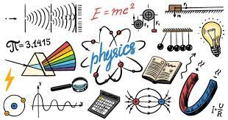
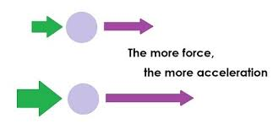
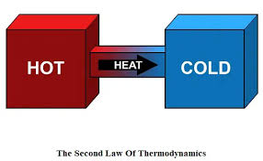
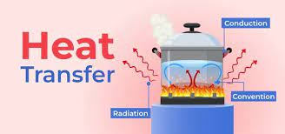
Course Contents:
Mid-Term Syllabus:
Week-1
Physics as natural science, Force, mass and weight.
Week-2
Newton's laws of motion and law of universal gravitation.
Week-3
work, energy and power (basic concepts).
Week-4
Heat, temperature, laws of thermodynamics and the human body.
Week-5
Thermometers and temperature scales. Survival in cold and hot climates.
Week-6
Transmission of heat via conduction, convection and radiation.
Week-7
Week-8
Mid-Term Examination

Slide 7
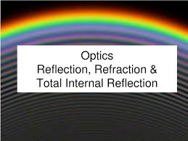
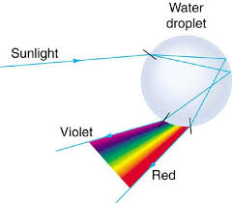
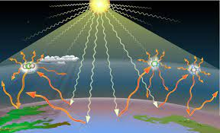
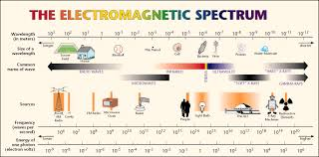
Final-Term Syllabus:
Week-9
Electromagnetic spectrum; Laws of reflection, refraction and total internal reflection.
Week-10
Lenses, prisms and Photoelectric effect.
Week-11
How do solar cells operate?
Week-12
Wind energy & wind mills; Clouds formation, lightening & thunderstorms.
Week-13
Greenhouse effect, Greenhouse gases & Global warming.
Weck-14
Electric charge & Coulomb's law.
Week-15
Electric potential and Electric current; Electric & magnetic fields.
Week-16
Final-Term Examination

Slide 8
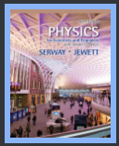
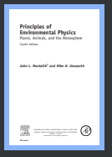
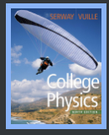
Recommended Books:
HD. Young, College Physics, Sears and Zemansky's, 9th Ed. 2012.
M. Dielalija, Environmental Physics, Split (2004)
D. Halliday, R. Resnick and J. Walker, Fundamentals of Physics, John Wiley & Sons, 10th Ed. 2013.
RA. Serway and J.W. Jewett, Physics for Scientists and Engineers, Golds Sunburst Series, 9th Ed. 2014.
N. Mason and P. Hughes, Introduction to Environmental Physics: Planet Earth, Life and Climate, Taylor and Francis (2001)
D. Botkin and E. Keller. Environmental Science: Earth as a Living Planet, 8h Edition, John Wiley and Sons, Inc (2000)
W.P. Cunningham and B.W. Saigo, Environmental Science, 6" Edition, McGraw-Hill (2001)
Note:
The Instructor may suggest any relevant latest reputed book's available
Reality Awards Boostup(YT-Channel)
The End

